Slide 1
Reusable Code For ASP.NET : User Control
Chapter 8

Slide 2
What Are You Going To Learn?
Creating User Control
Loading User Controls Programmatically
Custom Control

Slide 3
What is a User Control?
It is an ASP.NET page that has been converted into a control
file extension = .ascx

Slide 4
User Control
A user control can contain both HTML and Web Controls.
You can place multiple Web Form control in a user control and expose them as a single control.
A user control can contain the same event-handling subroutines as a normal ASP.NET page.

Slide 5
Advantages (Pros)
Enable you to reuse the same content and programming logic on multiple ASP.NET pages.
Used for repetitive elements (such as headers, menus, login controls and etc.) on page.
Reusability
Code reduction and encapsulation
Reducing the amount of code per page by encapsulation repetitive elements.
enable fragment caching
Improve performance

Slide 6
Limitations (Cons)
User controls aren't ideal for:
Separation of presentation HTML from the code blocks (server control).
Encapsulation of data access methods in a reusable package (Data access class/component).
Creating a control that can be reused more widely than in just the application (which can be achieved by custom control).

Slide 7
Question
Discuss the reasons of using User Controls in a Website over Master Page.
Notes:
Q1:
Both are code reduce features and reusability purpose
User control is a control that has to be added into a page, while Master Page serves like a template, where we add the ContentPlaceHolder in the Master Page to display the child page.
User controls are great to encapsulate markup, controls and code that you need repeatedly throughout your site, but should only appear on some but not all pages. While Master Pages allow you to create content that is displayed in all pages in your site

Slide 8
Question
Between user control and Master Page, evaluate which way is better to suit the following requirements for developing a website.
You wish to add common functionality in all pages. For example, every page will consist of a common header and footer.
There are 2 different groups of users who can login to a website. However, different group of users will see different menu after logging in.

Slide 9
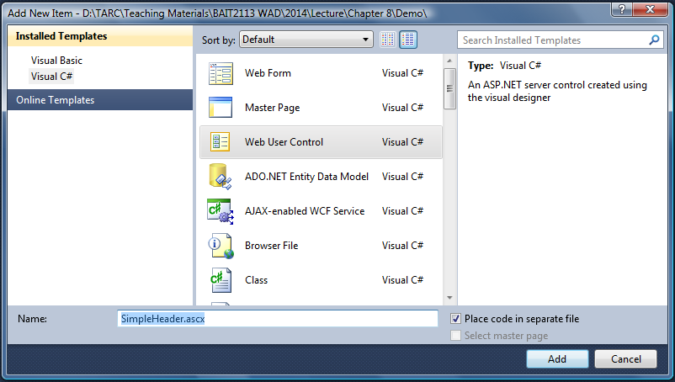
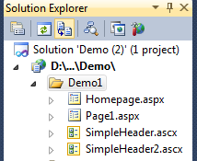
Creating a User Control

Slide 10
Adding a User Control on a Page
register a user control on a page:
adding the user control:
<%@ Register TagPrefix="SuperCompany" TagName="Header" Src="SimpleHeader.ascx" %>
<SuperCompany:Header ID="ctlHeader" runat="server"/>
Each control must have a unique ID if it is used for many times in a page.

Slide 11
Question
Based on information about a Web user control below, write the necessary code on a Web form (aspx file) to display the control.
TagPrefix: myMenu
TagName: MainMenu
Src: Menu.ascx
<%@ Register TagPrefix=" myMenu " TagName=" MainMenu " Src="~/Menu.ascx"%>
< myMenu : MainMenu ID=“Menu" runat="server"/>

Slide 12
Question
Provided the code snippets below that display 3 user controls on an aspx page, write the necessary codes to register the respective user controls of “header.ascx”, “menu.ascx” and “login.ascx”.
<control:Header ID="ctlHeader" runat="server"/>
<control:Menu ID = “ctlMenu” runat = “server” />
<login:Main ID= “ctlLogin” runat= “server” />
Notes:
<%@Register TagPrefix:”control” TagName:”Header” Src:”header.ascx” %>

Slide 13
Properties and Methods in User Controls
User control’s content can be static or dynamic
You can expose properties in a user control
All public variables declared in the user control file are exposed as properties of the user control
Function and subroutines contained in the user control are exposed as methods of the user control.

Slide 14

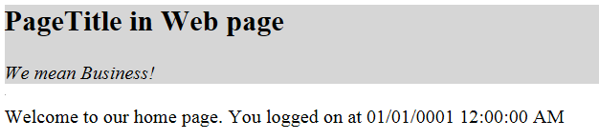
Properties in User Controls
We can assign a value to a user control property programmatically.
Consider we would like to create a property called PageTitle for the PageHeader user control:
lblPageTitle
PageHeader
PageTitle
PageTitle
PageHeader

Slide 15
Properties in User Controls
In PageHeader.ascx.cs
Create a property called PageTitle for the PageHeader user control:
public partial class PageHeader : System.Web.UI.UserControl
{
public string PageTitle = “PageTitle in User Control";
protected void Page_Load(object sender, EventArgs e)
{ lblPageTitle.Text = PageTitle;
}
}
display the PageTitle on the label
The public variable will be accessed by all pages that contains the PageHeader user control.

Slide 16
Properties in User Controls
In Homepage.aspx
Set the property called PageTitle for the PageHeader user control:
<%@ Register TagPrefix="Page" TagName="Header" Src="PageHeader.ascx" %>
<Page:Header ID="ctlHeader1" runat="server"
PageTitle="PageTitle in Web page"/>
display the PageTitle on the label in PageHeader control
To overwrite the default title, you can set the value of the PageTitle property in the user control tag

Slide 17
Question
Assume that the user control “Convert.ascx” consists of a property called MinValue. Demonstrate in code how to include the user control in an ASP.NET Web page, and set the MinValue to 1 declaratively, with appropriate TagPrefix and TagName settings.

Slide 18
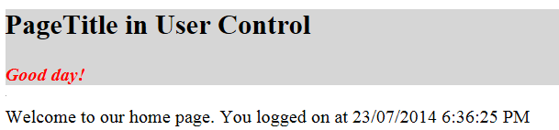
Method in User Controls
We can also expose methods in a user control programmatically.
Consider we would like to create a method called CheckTime for the PageHeader user control.
Rule:
IF CurrentTime < 12.00pm
THEN Display “Good morning!”
ELSE Display “Good day!”
lblMessage
PageHeader

Slide 19
Method in User Controls
In PageHeader.ascx.cs
Create a function called checkTime for the PageHeader user control:
public partial class PageHeader : System.Web.UI.UserControl
{
public DateTime loginDate;
public void checkTime()
{
string message = "Good day!";
if (loginDate.Hour < 12)
message = "Good morning!";
lblMessage.Text = message;
}
}
The public method will be accessed by all pages that contains the PageHeader user control.
display the message on the label in PageHeader control

Slide 20
Method in User Controls
In Homepage.aspx.cs
Consider we would like to create a property called PageTitle for the PageHeader user control:
protected void Page_Load(object sender, EventArgs e)
{
ctlHeader.loginDate = DateTime.Now;
lblDate.Text = Convert.ToString(ctlHeader.loginDate);
ctlHeader.checkTime();
}
set the loginDate property of PageHeader control
call the checkTime method of PageHeader control

Slide 21
Loading User Controls Programmatically
User control can be generated dynamically (programmatically) by using LoadControl() method.
Consider we would like to load a specific user control based on user’s gender.
Rule:
IF gender = ‘male’
THEN Load “MaleAd.ascx”
ELSE Load “FemaleAd.ascx”

Slide 22
Loading User Controls Programmatically
In Homepage.aspx.cs
load a specific user control based on user’s gender.
protected void Page_Load(object sender, EventArgs e)
{
if(!IsPostBack)
{ string gender = “male”;
Control ctlControl;
if(gender == “male”)
ctlControl = LoadControl(“maleAd.ascx”);
else
ctlControl = LoadControl(“femaleAd.ascx”);
plhAd.Controls.Add(ctlControl);
}
}
load control dynamically
adding the control to a PlaceHolder control called plhAd
Notes:
The PlaceHolder (plhFeatured) enables you to place an empty container control within the page and then dynamically add, remove, or loop through child elements at run time.
Use the PlaceHolder control as a container to store dynamically added server controls to the Web page

Slide 23
Question
You plan to display a personalized advertisement banner on the home page (Default.aspx) of a Website based on the gender of the user. If the user is a male, the user control named “watch.ascx” will be displayed in a PlaceHolder control named “phBanner”. If the user is a female, then the “makeup.ascx” control will be displayed.
When the user accesses to the home page, the gender will be retrieved from a Cookie named “gender” and will be stored into a session variable named “Sex”. However, if the cookie does not exist, then a user control named “general.ascx” will be displayed.
Demonstrate your code in Page_Load event handler to achieve the requirements above.
Notes:
if (Request.Cookies["Gender"] != null)
{
string strGender = Request.Cookies["Gender"].Value;
string strSrc = "";
if (strGender == "Male“)
strSrc = "Watch.ascx";
else if (strGender == "Female")
strSrc = "Makeup.ascx";
else
strSrc = "General.ascx";
Control ctrBanner = LoadControl(strSrc);
phBanner.Controls.Add(ctrBanner);
Session["Sex"] = Request.Cookies["Gender"].Value;
}

Slide 24
Custom Control
Three ways to create a custom control:
derived custom control
deriving from an existing control.
composite control
grouping existing controls together into a new compiled control.
full custom control
deriving from System.Web.UI.WebControls.WebControl.
Composite controls are most similar to user controls.

Slide 25
User Control vs. Custom Control
User Controls
Custom controls
These are like .aspx pages
Extension is .ascx
supports Caching
Easier to create
Good for static layout
These are .DLL files
these are precompiled components
does not support caching
Harder to create
Good for dynamic layout

Slide 26
User Control vs. Custom Control
User Controls
Custom controls
Limited support for consumers who use a visual design tool
A separate copy of the control is required in each application
Cannot be added to the Toolbox in Visual Studio
Full visual design tool support for consumers
Only a single copy of the control is required, in the global assembly cache
Can be added to the Toolbox in Visual Studio

Slide 27
Question
Briefly describe the differences between a user control and a custom control.

